Slide 1
Gaming – Backtracking
Santosh GSK
Industry Expert- AI

Slide 2
Game characteristics
Observability
Refers to how much information about the game state is available
Stochasticity
It is the non-deterministic behavior of games, e.g., Card Games, Dice rolls
Time Granularity
Number of actions a player can take in a second
Number of Players
Multiplayer games

Slide 3
Stochastic Games
Many games have random behavior built-in with elements like throwing dice, permutation of cards

Slide 4
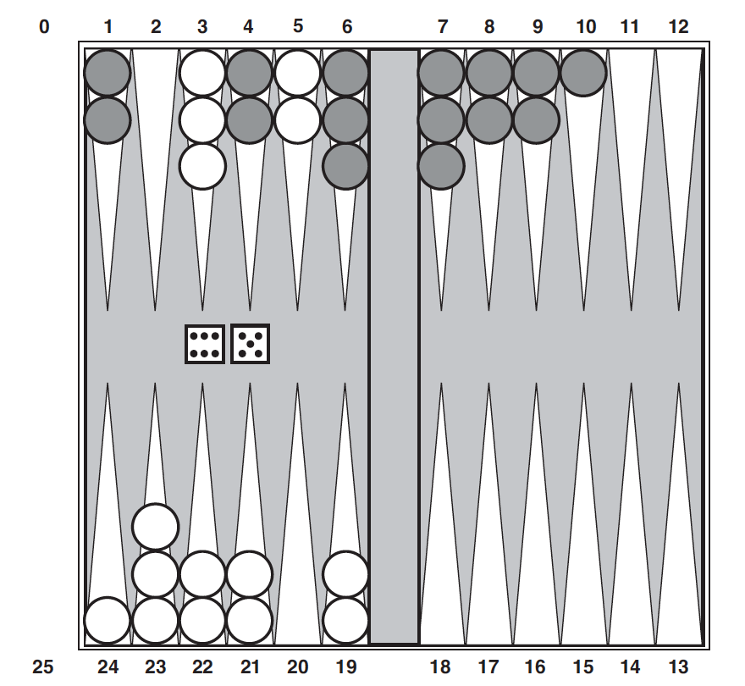
Stochastic Games
Backgammon is a game that combines luck and skill
Dice are rolled at every turn to determine the number of legal moves by a player
White has rolled 6 and 5
Legal moves can be (5-10, 5-11), (5-11, 19-24), (5-10, 10-16), (5-11, 11-16)
Until the dice is rolled, cannot construct a Game Tree like in Chess, Tic-Tac-Toe

Slide 5
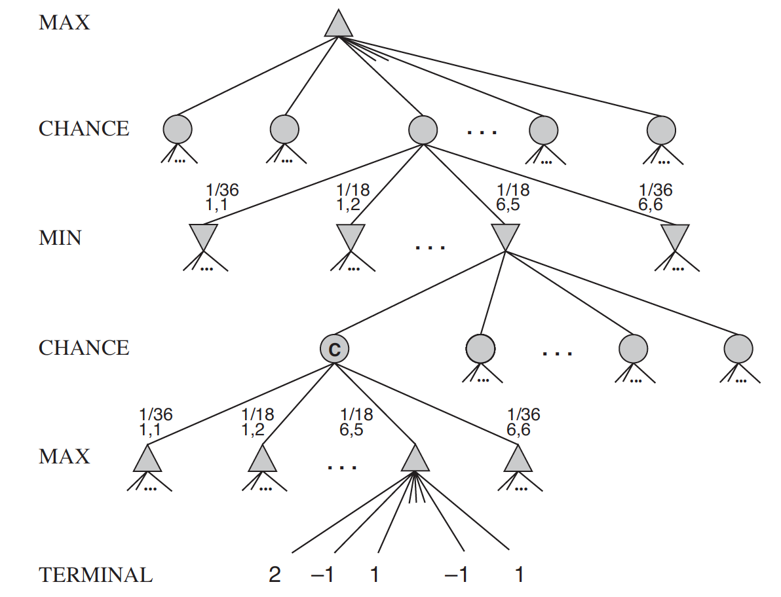
Stochastic Games
To handle stochasticity, add “chance nodes” to game tree in addition to MAX and MIN
Each branch from a chance node is a possible dice combination with a probability

Slide 6
Stochastic Games Strategy
Define the strategy for game playing in stochastic games
Here, state nodes do not have minimax values
However, expected values can be calculated, i.e., average of all possible values

Slide 7
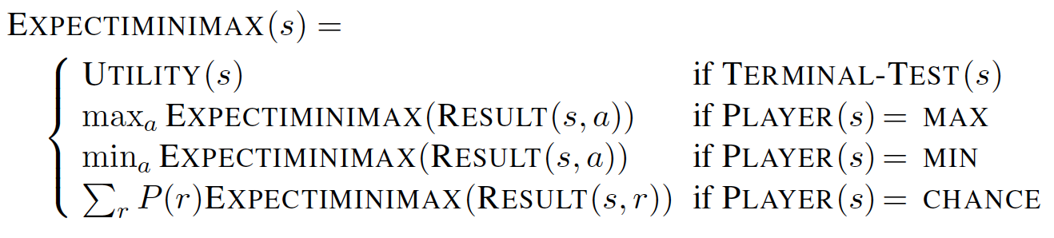
Stochastic Games Strategy
Expectiminimax value – Modified minimax value to include chance nodes
In the modified game tree
Terminal nodes, MAX and MIN nodes work exactly as before
Chance nodes – expected values are computed as a sum of all outcomes weighted by their probability (of dice roll in Backgammon)

Slide 8
Partially Observable Games
Card games provide many examples of stochastic partial observability
Cards are dealt with randomly at the beginning of game
Each player receiving a hand not visible to the other players

Slide 9
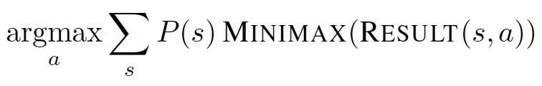
Partially Observable Games Strategy
In Games like Super Mario Bros, we perceive the raw pixels and actions are taken to optimize based on that partial information
However, in Card games
We consider all possible deals of invisible cards
Solve each one as if it is a fully observable game
Choose the move that has best expected outcome over all deals
Suppose deal s occurs with Probability P(s), then the move would be

Slide 10
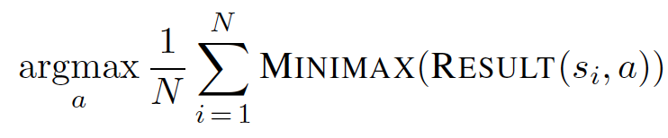
Partially Observable Games Strategy
However, in most card games, number of possible deals is quite large
In such scenarios, Monte Carlo approximation is preferred, where
Instead of adding up all the deals, we sample N random deals where each deal s is sampled with its probability P(s)
Based on that, the possible action would be
As N grows, it would be closer to the exact value based on full population
However, for a small N – 100 to 10000 it gives a good approximation

Slide 11
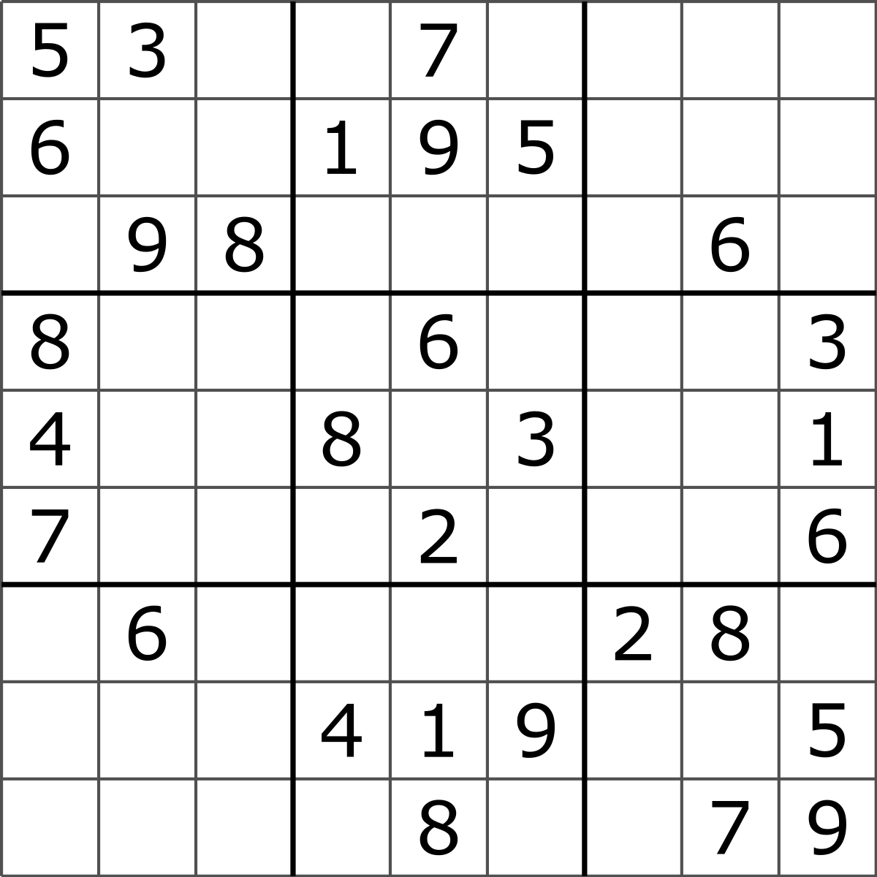
Constraint Satisfaction
In games like Sudoku, we need to find a solution adhering to constraints
Constraints are also required in solving other real-world problems like Job shop scheduling, vehicle routing, etc.

Slide 12
Constraint Satisfaction Problem
A problem is solved when each variable has a value that satisfies all the constraints on that variable
A problem with such a definition are called as Constraint Satisfaction Problem or CSP
The major idea behind CSPs is to eliminate large swathes of search space by identifying the variable-value combinations that satisfy the constraints

Slide 13
Defining CSP
A Constraint Satisfaction Problem consists of three components X, D and C
X – set of all variables {X₁, X₂, X₃, … , X_{n}}
D – set of domains, one for each variable {D₁, D₂, D3, …, D_{n}}
C – set of constraints that specify allowable combinations of values

Slide 14
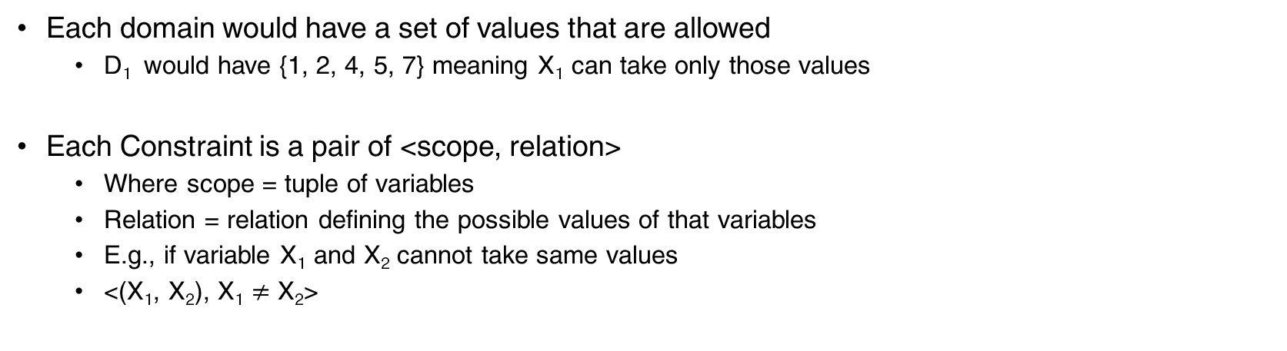
Defining CSP
Each domain would have a set of values that are allowed
D₁ would have {1, 2, 4, 5, 7} meaning X₁ can take only those values
Each Constraint is a pair of <scope, relation>
Where scope = tuple of variables
Relation = relation defining the possible values of that variables
E.g., if variable X₁ and X₂ cannot take same values
<(X₁, X₂), X₁ $≠$ X₂>

Slide 15
Defining CSP
A state in CSP
Assignment of values to each variable
An assignment that does not violate any constraint is a consistent or legal assignment
A complete assignment is one where every variable is assigned a value
A partial assignment is one where few variables are assigned values

Slide 16
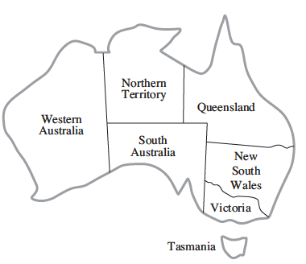
Example
Task: Fill each state with a color chosen randomly from {Green, Blue, Red}
Constraint: No two neighbors should have the same color

Slide 17
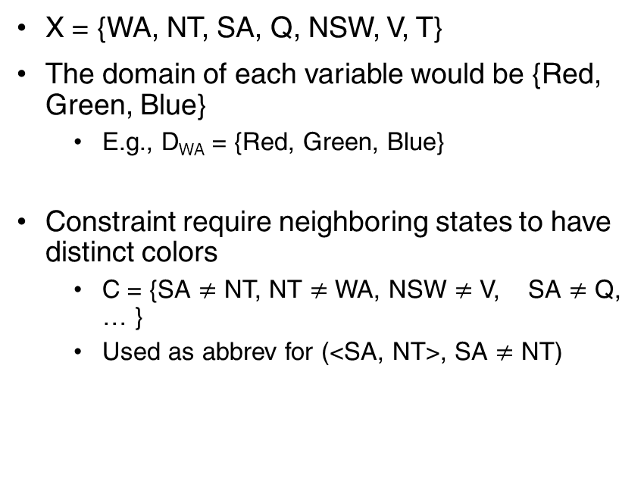
Example
X = {WA, NT, SA, Q, NSW, V, T}
The domain of each variable would be {Red, Green, Blue}
E.g., D_{WA} = {Red, Green, Blue}
Constraint require neighboring states to have distinct colors
C = {SA $≠$ NT, NT $≠$ WA, NSW $≠$ V, SA $≠$ Q, … }
Used as abbrev for (<SA, NT>, SA $≠$ NT)

Slide 18
Why formulate in CSP
CSP solvers are faster than state-space searches as CSP eliminates large swathes of search spaces by having constraints
E.g., If (SA = blue), then its five neighbors cannot have ”blue”
Reducing the possible search space to 2⁵ = 32 instead of the original 3⁵ = 243
Many problems that are intractable in state-space search can be searched quickly when formulated in a CSP
If a partial assignment is not a solution, we discard all further refinements
Furthermore, the variables that are violating the constraints are found and prioritize leading to quicker results

Slide 19
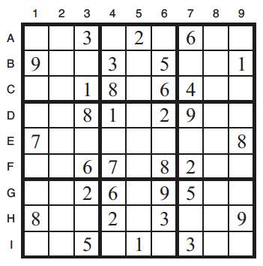
CSP for Sudoku
Total variables = 81
One for each square
X = {A1, A2, A3, ..., A9, B1, B2, …}
Domains
Empty Squares has {1, 2, 3, 4, 5, 6, 7, 8, 9}
Filled Squares has only one value as provided
Constraints
A1 – A9 should all be distinct, …
A1 – I1 should all be distinct, …
A1-3, B1-3, C1-3 should all be distinct, …

Slide 20
Backtracking Search for CSP
Backtracking – a special variant of depth first search
The tree would have
State as a partial assignment
Action would be assigning a value to a variable

Slide 21
Backtracking Search for CSP
For a CSP with n variables and d domain size for each variable
At the top level, the branching factor would be n * d
At the next level, the branching factor would be (n-1) * d
The tree would have n! * d^{n} leaves
However, there are only d^{n} possible assignments

Slide 22
Backtracking Search for CSP
Crucial property of CSP : Commutative
The order of assignments do not impact the problem
E.g., <SA = red, NT = blue> and <NT = blue, SA = red> are the same assignment

Slide 23
Backtracking search for CSP
In order to reduce the complexity of tree expansion
Use the commutative property
Use one variable at a particular depth
Enumerate all its values and move on to next variable at next depth
E.g., at the root node for Australian states coloring the possible actions would be <SA = blue, SA = red, SA = green> but not <SA = blue, WA = red>
This would reduce the search space to d^{n}

Slide 24
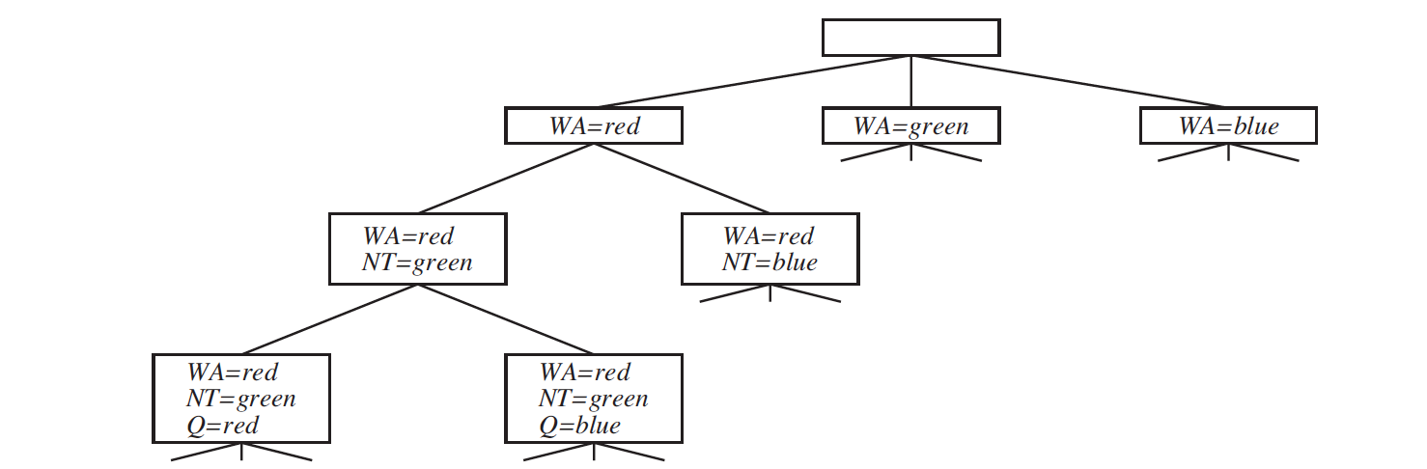
Backtracking Search for CSP
Algorithm
Chooses one value for a variable at a step
When a variable at a node has no legal values left to be assigned
It backtracks and assigns a different value for the parent variable and tries again

Slide 25
Backtracking Search
In strategic games like StarCraft, we have partial observability as the only observable state is the set of pixels
However, it is tough to take an action purely based on raw pixels
One can never predict when the enemy would enter
A good play involves active information gathering
Backtracking is required to remember off-screen parts of the level

Slide 26
Thank You!
In our next session:
NLP Syntax

